Slide 1
Maternal, infant and young child nutrition
Member States briefing
20 October 2020
20/10/2020
1

Slide 2
Maternal, infant and young child nutrition at EB 146
The report describes actions taken in the last few years to carry out the comprehensive implementation plan on maternal, infant and young child nutrition, with actions on:
Creating a supportive policy environment
Delivering effective health and nutrition interventions
Stimulate multi-sectoral actions beyond the health sector
Increase human and financial resources for nutrition interventions
Improve monitoring and evaluation
The report also documents some progress on implementing national legislation regarding the Code, but points out growing areas of concern with conflicts of interest in health professional organizations and increasing use of digital marketing to promote breast-milk substitutes.

Slide 3
Draft decision proposed in document EB 146/24

Slide 4
Draft decision as amended in EB146

Slide 5
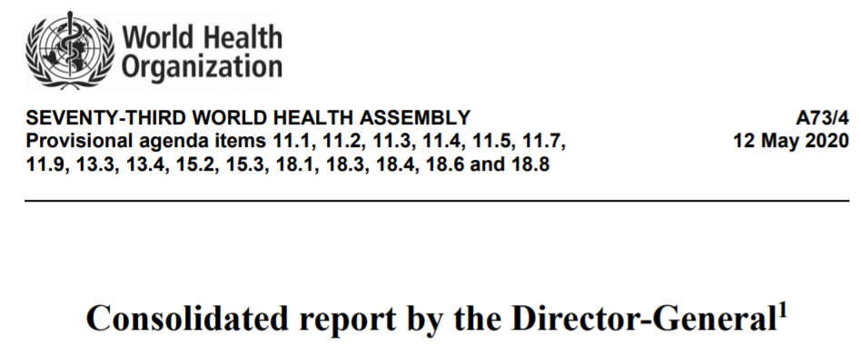
Maternal, infant and young child nutrition at WHA 73

Slide 6
Draft decision proposed for WHA 73 (1)
The Seventy-third World Health Assembly, having considered the report on the Comprehensive implementation plan on maternal, infant and young child nutrition, and recalling the mandates given in resolutions and decisions on: the International Code of Marketing Breastmilk Substitutes (WHA34.22 (1981), WHA35.26 (1982), WHA37.30 (1984), WHA39.28 (1986), WHA41.11 (1988), WHA43.3 (1990), WHA45.34 (1992), WHA46.7 (1993), WHA47.5 (1994), WHA49.15 (1996), WHA54.2 (2001), WHA58.32 (2005), WHA59.21 (2006), WHA61.20 (2008) and WHA63.23 (2010)); the WHO/UNICEF Global Strategy for infant and young child feeding (WHA55.25 (2002)); the WHO Global Comprehensive Implementation Plan on Maternal, Infant and Young Child Nutrition (WHA65.6 (2012)); Ending inappropriate promotion of foods for infants and young child (WHA69.9 (2016) and WHA71.9 (2018)); and Ending childhood obesity (WHA69(12) (2016) and WHA70(19) (2017)), decided to:

Slide 7
Draft decision proposed for WHA 73 (2)
Streamline future reporting requirements on maternal, infant and young child nutrition, through biennial reports until 2026 2030 (to be issued in 2022, 2024, 2026, 2028, and 2030 respectively); and
Request the Director-General to review current evidence collect data and prepare a comprehensive report to understand the scope and impact of digital marketing strategies for the promotion of breast-milk substitutes substitutes and develop guidance to assist Member States to address any promotion of BMS that may not be in accordance with the International Code of Marketing of Breastmilk Substitutes and subsequent relevant WHA resolutions to the 75th World Health Assembly (2022), through the Executive Board.

